Slide 1

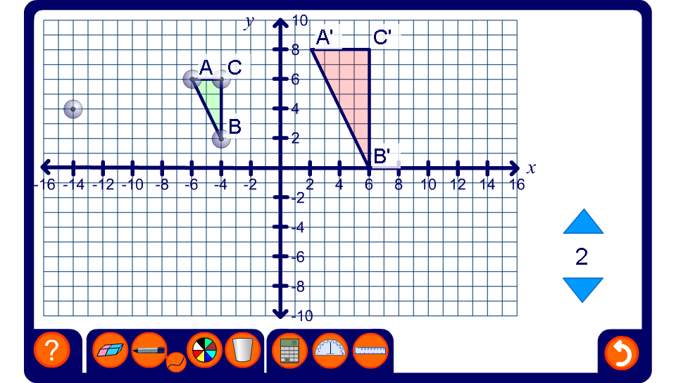


Enlargement on a coordinate grid
Notes:
Start by investigating the relationship between the coordinates of the original shape and its enlargement when the centre of enlargement is at the origin. Vary the shape, its position and the scale factor for the enlargement.
Move the centre of enlargement to explore the relationship between the position of the centre of enlargement and the position of the image. Demonstrate examples where the centre of enlargement is inside the shape, on an edge or on a vertex.
Establish that the further the centre of enlargement is from the object, the further the image is from the object.

